Slide 1

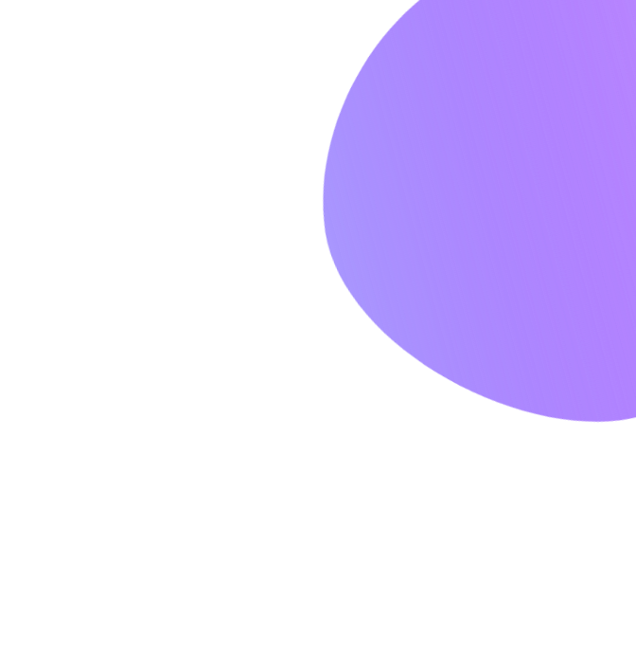


Join our masterclass
Let’s Make
Design Generators
Great Once Again
Learn how to leverage digital design generators like heazy.studio and circumvent the saturated world of boring designs.

Slide 2

HEAZY
SESSIONS

Slide 3


GENERATE UNIQUE DESIGNS
AND SAVE YOURSELF TONS OF TIME FOR ACTUAL CODING
Try it out now

Slide 4
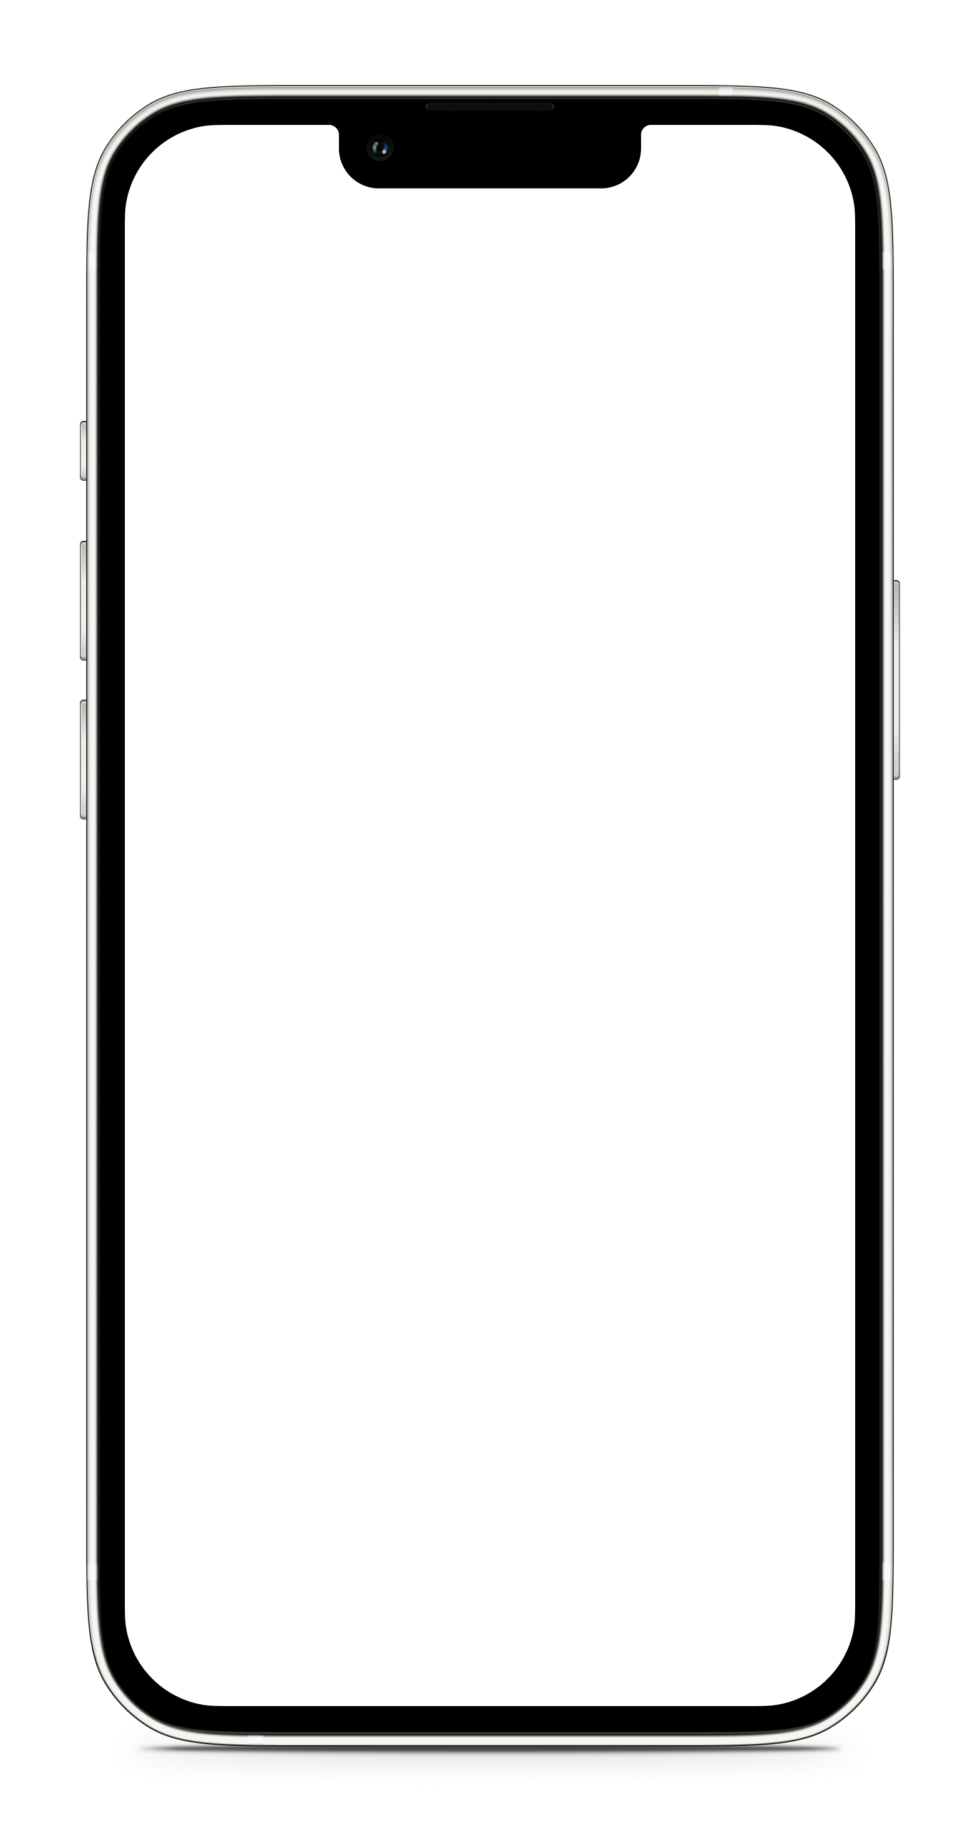


NO MORE FEAR OF
CREATIVE PROCESSES
Heazy will save you hours of procrastination. Guaranteed.
MORE INFO

Slide 5

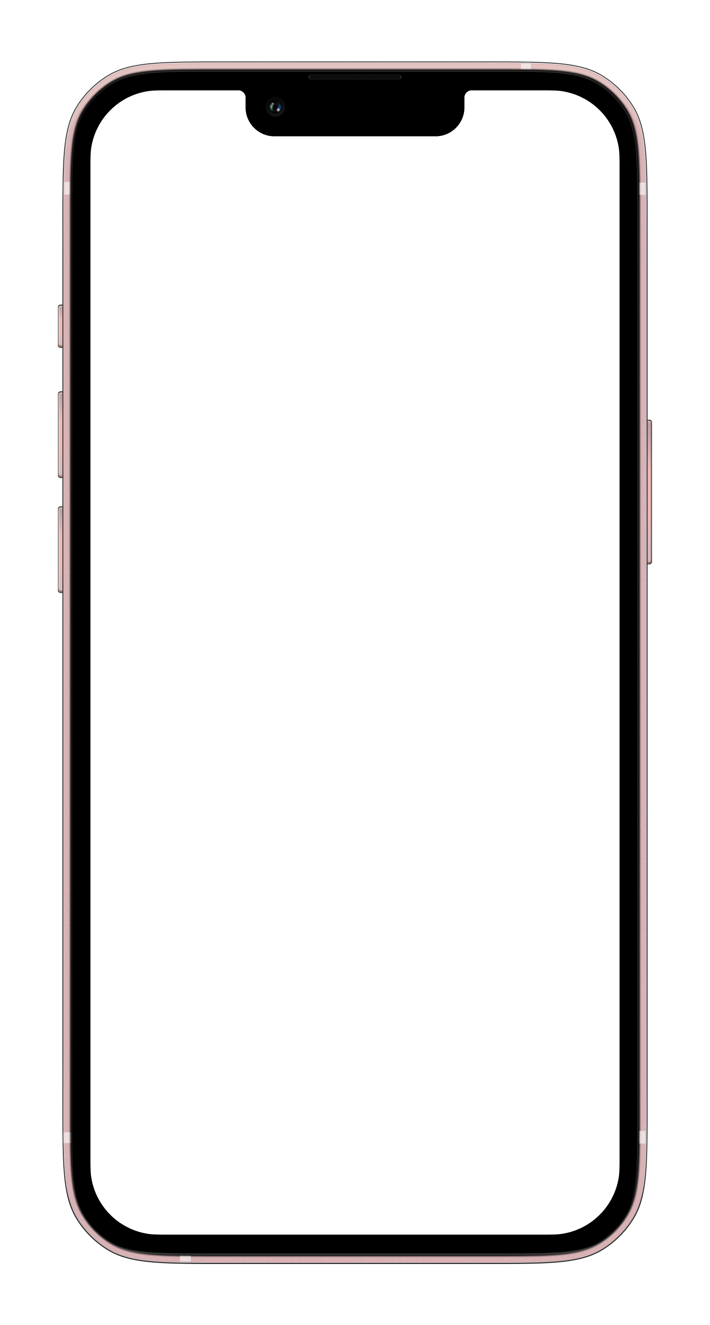




Login
Please sign in to continue
EMAIL
heazy@studio.com
PASSWORD
Login

